Slide 1

Southern Water Crop
Statistical Analysis
Presented by James Luu Springboard Presentation 2021

Slide 2
Summary of Statistical Analysis
As a data analyst, my objective is to use descriptive and inferential analysis to tell a meaningful story that drives respective insights for both stakeholders, and the engineers. My goal is to identify if the is pump performing abnormally and see why. By doing so, I can help the engineer reduce overcall production cost, and improve the company market’s economics.

Slide 3
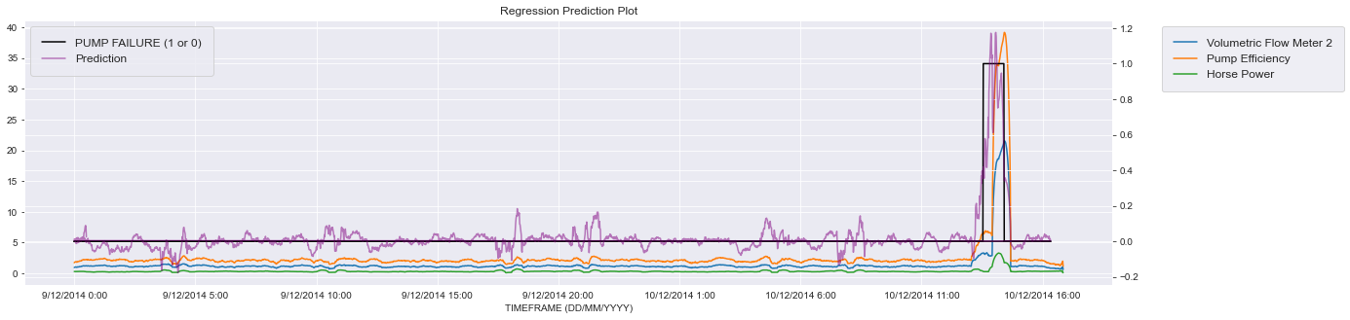
Executive Summary:
Southern Water Corp can reduce its overall production cost and improve economics' market by predicting when pump failure 1 is occurring with statistical analysis.

Slide 4
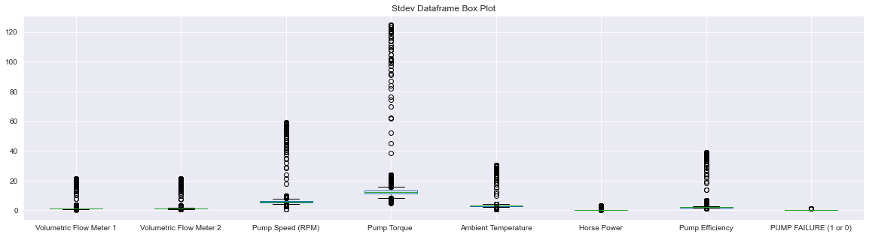
Using descriptive analysis on the standard deviations of the dataset, the boxplot shows tons of outliers highlighting that the average output of each variable is skewed and has high variabilities.

Slide 5
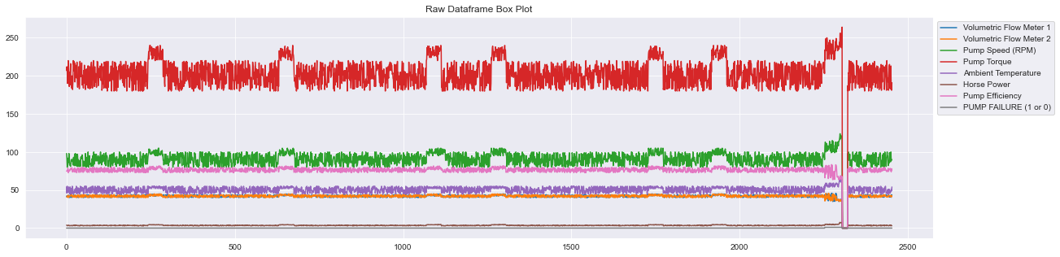
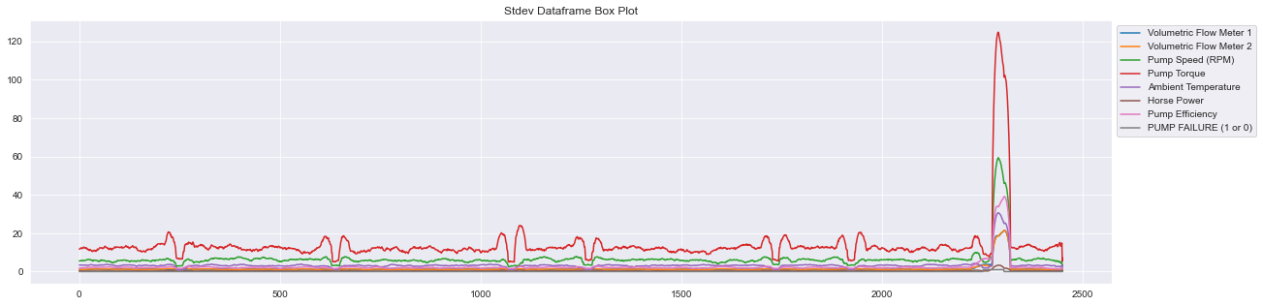
This is support by the time series line plot, as you can see there is a clear abnormality showing changes in both raw data and standard deviations over a period.

Slide 6
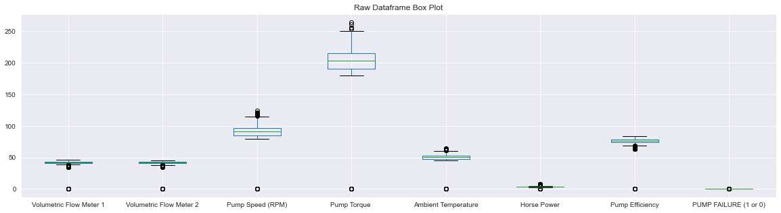
Why not use raw data?
With using the raw data, it is often unreliable as the change in one variable does not necessarily show there is a huge change for each variables as the average data is skewed by the overall value rather than a 30-minute interval check.

Slide 7
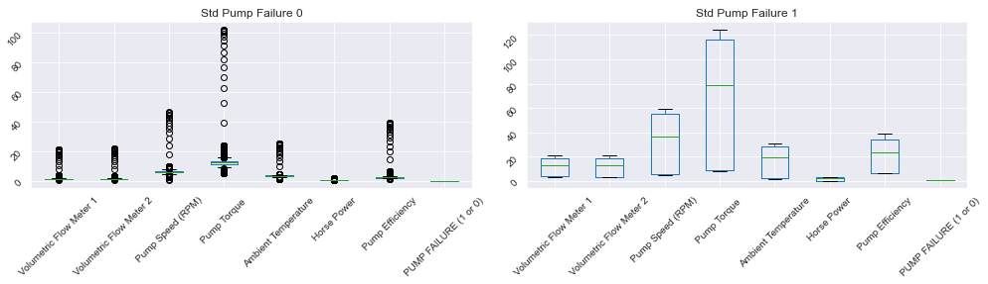
Standard Deviational Data
Comparing pump failure 0 to 1, it highlight that pump failure causes changes in variability with graph 2 having no outliers and box being large in dimensions.

Slide 8
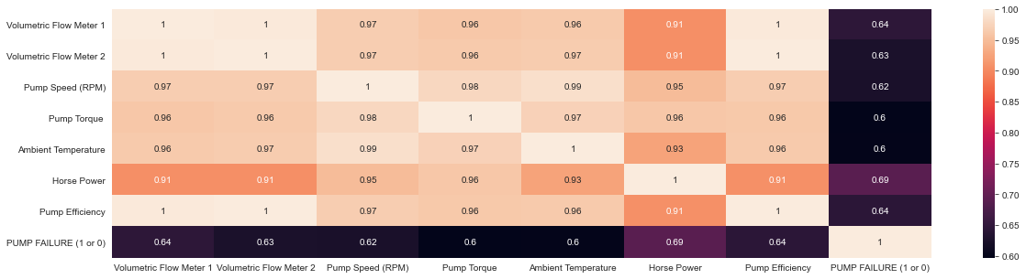
Predict Data Using Inferential Statistics
With inferential statistics, on the standard deviation dataset, there is a strong response to volumetric flow meter, pump efficiency and horsepower that directly correlates from pump failure.

Slide 9
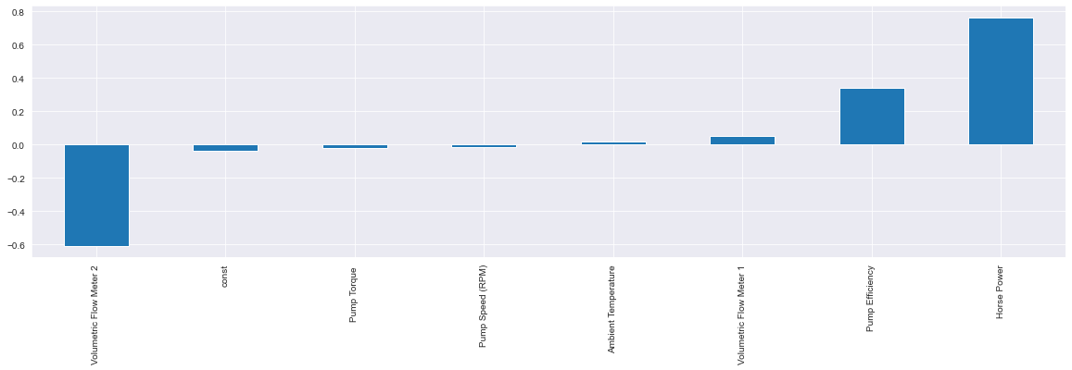
Lastly, with an R Squared of .78, this linear model is a good fit to show which variables coefficient affects the chance of pump failure 1 occurring. Flow Meter 2 having a -.60% effect on pump failure for each unit, while pump efficiency and horsepower have a positive effect that may cause pump failure.

Slide 10
Final Words
By identifying which variable is changing such as volumetric flow meter, pump efficiency and horsepower, we can ideally monitor and fix it to reduce the chances of pump failure occurring. Having pump failure at 0 would ideally increase our profit, improve economic market, and reduce overall production cost.

